Slide 1

Predicting Loan Eligibility with Machine Learning
Presented By
Prathamesh Lohar (112115079)
Chaitanya meshram (112115088)
Sanket Gayke (112115052)

Slide 2
Problem statement:
Financial institutions need efficient and accurate loan eligibility assessment. Traditional methods are slow and limited, leading to suboptimal decisions. We aim to develop machine learning models that automate and enhance this process, ensuring accuracy, fairness, transparency, and compliance.

Slide 3
Why is predicting loan eligibility crucial for financial institutions?
To emphasize the significance of predicting loan eligibility for financial institutions.
To explain how prediction enhances decision-making in lending.
highlight the impact of loan eligibility prediction on the customer experience.

Slide 4
Dataset Overview
Source of the dataset
we have collected the dataset from Kaggle for the topic loan predictions.
https://www.kaggle.com/datasets/vikasukani/loan-eligible-dataset
Data description
Key variables (Loan ID ,Gender, Married ,Dependents, Education, Self Employed , Applicant Income, Co-applicant Income, Loan Amount, Loan Amount Term, Credit History ,Property Area.)

Slide 5
Data Preprocessing
Handling Missing Values:
Decide how to handle missing values. Options include imputation with mean, median, mode, or dropping rows with missing values.
Encoding Categorical Variables:
Convert categorical variables like "Gender," "Married," "Dependents," "Education," "Self_Employed," and "Property_Area" into numerical format.
Data Scaling:
Standardize or normalize numerical features like "ApplicantIncome," "CoapplicantIncome," "LoanAmount," and "Loan_Amount_Term" to ensure that all variables are on the same scale.

Slide 6
Handling Outliers:
Check for outliers in numerical features. You can use statistical methods or visualizations to identify and handle outliers.
Feature Engineering:
Create new features if necessary. For example, you can calculate the total income by adding "ApplicantIncome" and "CoapplicantIncome”.
Data Splitting:
Split the dataset into training and testing sets to evaluate the machine learning model's performance. The target variable should be separated from the features.

Slide 7
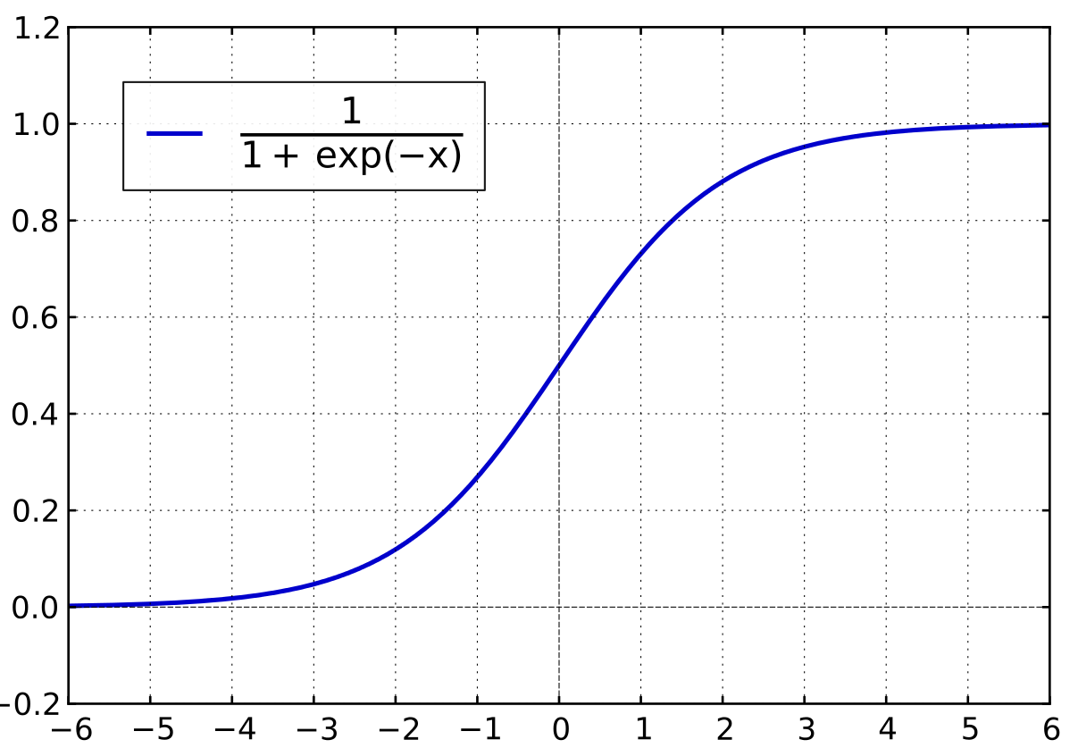
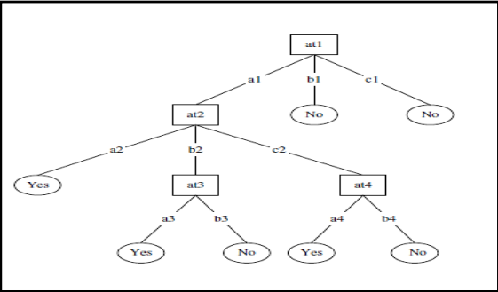
LOGISTIC REGRESSION ALGORITHM
- Logistic regression is a popular Supervised Learning algorithm used to estimate categorical dependent variables based on independent variables. It predicts a categorical value through probabilistic values ranging from 0 to 1. Unlike Linear Regression, which is used for regression problems, logistic regression is generally used for classification problems.
sigmoid function=1/(1+e^{-x})
2. DECISION TREE ALGORITHM
- The decision tree method uses a decision-boosting machine to predict energy consumption by identifying key predictors. Multiple trees are built, utilizing previous tree information to improve accuracy, with tuning parameters optimized for better performance.

Slide 8
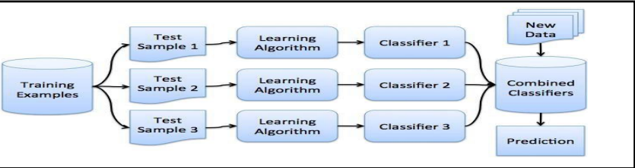
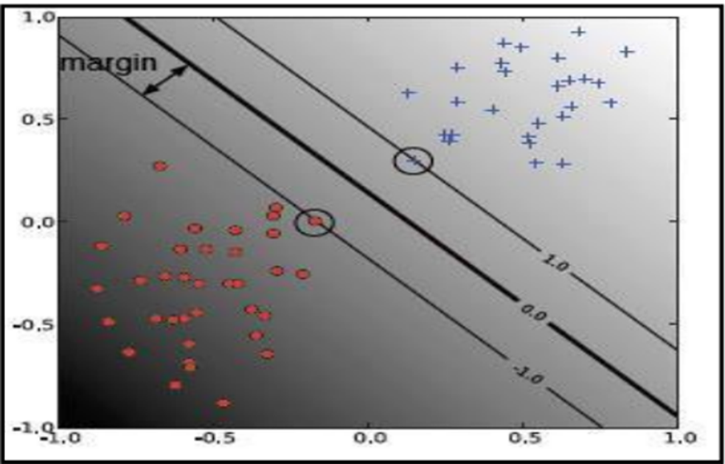
3. RANDOM FOREST ALGORITHM
- It divides data into random samples and draws
decision trees for each sample.
Then It combines all decision trees to make
final decision.
- It helps to increase accuracy of decision tree.
4. SUPPORT VECTOR MACHINE (SVM) ALGORITHM
-At First support vectors are drawn and margins are maximized.
-After that Hyperplane is drawn in such a way that it classifies data into different parts.
- SVM offers a tree-based approach to stratify predictor space into sample regions and can handle high-dimensional data

Slide 9
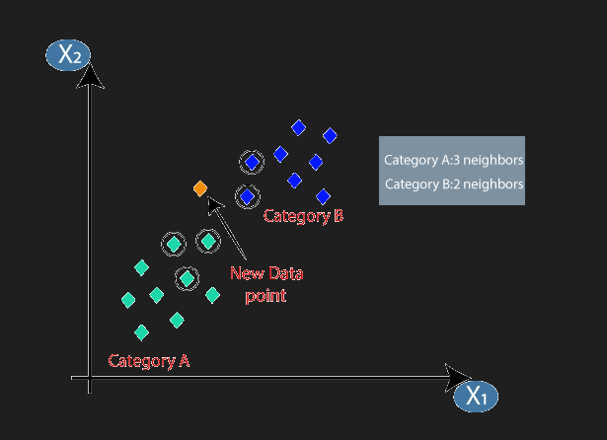
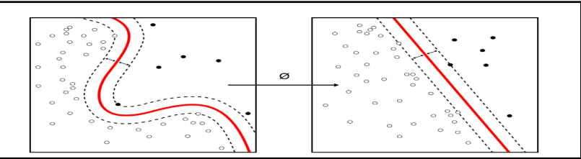
5. K-NEAREST NEIGHBOR(kNN) ALGORITHM
- K-nearest neighbor algorithm uses data directly for classification without building a model, with k representing the number of nearest neighbors used for estimating class membership.
While KNN is simple and can provide justification for classification outcomes, calculating the case neighborhood requires defining a distance metric between data objects, which is a major drawback.
6. NAIVE BAYES ALGORITHM
Bayes theorem:
P(A | B) =P(B/A)*P(A)/P(Total)
- Naive Bayesian can compare multiple generalized additive models with different types of output variables, including subset selection and variables with high relative influence.
The model with the best prediction accuracy can be identified using Naive Bayesian.

Slide 10
Model Evaluation
Accuracies of all implemented model:
Logistic Regression - 0.7723577235772358 %
Naive Bayes - 0.7886178861788617 %
Random Forest - 0.8292682926829268 %
Decision Tree - 0.6829268292682927 %
Support Vector Machine - 0.7073170731707317%
k-Nearest Neighbors(kNN) - 0.5853658536585366%

Slide 11
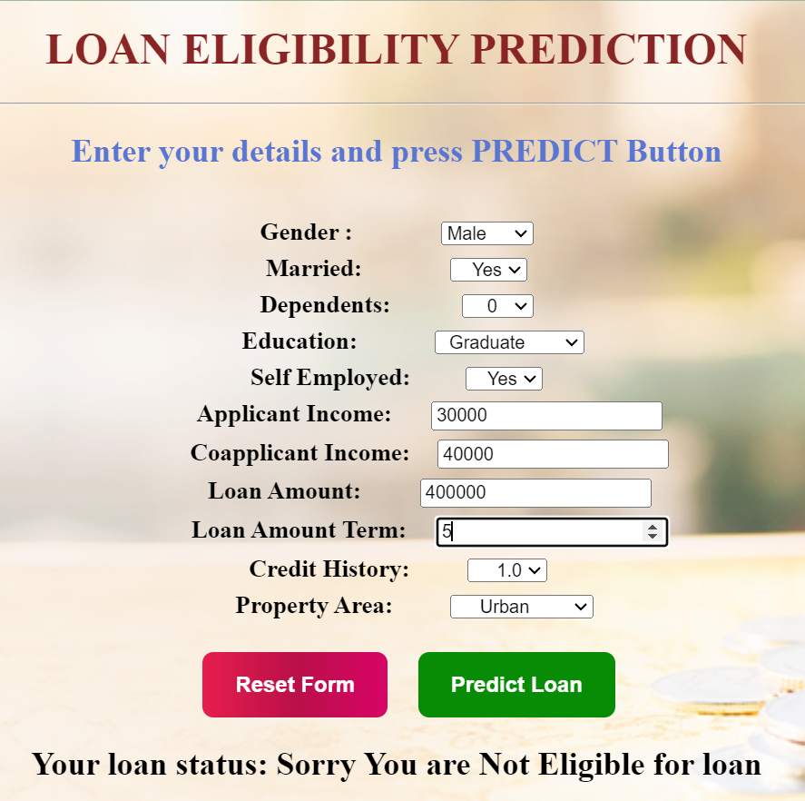
Model Selection
- As per Accuracy of above models we have selecte the best performing algorithm in our model
Random Forest - 0.8292682926829268 %
Final Web application with Random forest Algorithm

Slide 12
Conclusion
The application of machine learning algorithms to predict loan eligibility has the potential to revolutionize the lending industry. This technology offers a data-driven approach that enhances decision-making for financial institutions and improves the overall customer experience
1. Risk Reduction and Informed Decisions:
2. Automation and Efficiency:
3. Enhanced Customer Experience:2. Automation and Efficiency:

Slide 13
Thank you!

